Slide 1
The machines behind computing
Crisanto T. Ogatis
Shiela Marie S. Vicente
England Ford Estacio
Myra D. Sitchon

Slide 2
Define Computer
If airlines had developed as computers have developed, today you could go around the globe in less than 20 minutes for just 50 cents. Computers have gone through drastic changes in a short time.

Slide 3
Components of a computer system
A computer system consists of hardware and software. Hardware components are physical devices, such as a keyboards, monitors, and processsing units. The software component consists of programs written in computer languages.

Slide 4
The Build blocks of a computer

Slide 5
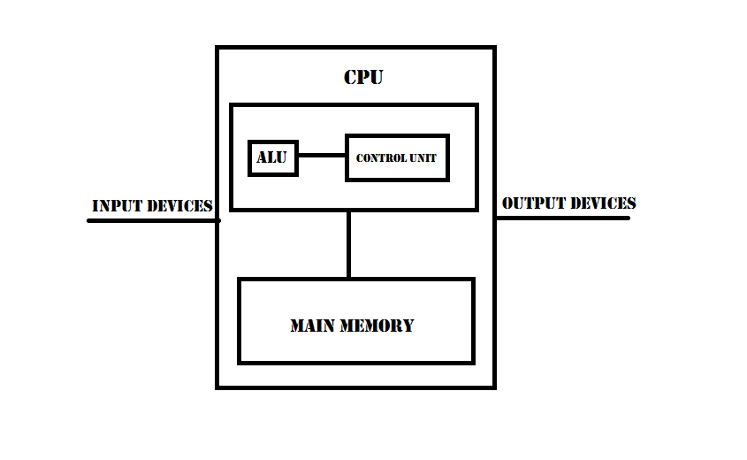

Slide 6
The History if Computer Hardware and Software

Slide 7
Major developments in hardware have taken place over the past 60 years. To understand these developments better, computers are often categorized into “generations” to mark technological breakthroughs. Beginning in the 1040s, first generation computer used vacuum tube technology. They were bulky and unreliable, generated excessive heat, and were difficult to program.

Slide 8
The Power of Computers
Computer draw their power from three factors that far exceed human capacity: speed, accuracy, and storage and retrieval capabilities in the following sections.

Slide 9
Computer Operations
Computers can perform three basic tasks: arithmetic operations, logical operations, and storage and retrieval operations. All other tasks are carried but one or a combination of these operation.

Slide 10
Input Devices
Input devices send data and information to the computer. The following input devices are constantly being improved to make Data input easier.

Slide 11
Keyboard
Are the most widely used input devices. Originally, they were designed to resemble typewriters, but several modifications have been made to improve their easy of use.

Slide 12
Mouse
Is a pointing devices for moving the cursor onscreen and allows fast, precise cursor positioning.

Slide 13
Touch screen
Which usually work with menus, are actually a combination of input devices.

Slide 14
Light Pens
Are connected to the monitor with a cable. When the pen is placed on an onscreen location, the data in this spot is sent to the computer.

Slide 15
Trackball
Is kept in a stationary location, but it can be rolled in different directions to control the onscreen cursor.

Slide 16
Output Devices
An output device is capable of representing information from a computer. The form of this output might be visual, audio, or digital and examples include printers, display monitors, and plotters.

Slide 17
Memory Devices
Two types of memory are common to any computer:
Main Memory stores data and information and is usually volatile, meaning its contents are lost when electrical power is turned off.
Secondary Memory which is nonvolatile, holds data when the computer is off or during the course of a programs operation. It also serves as archival storage.

Slide 18
Main Memory Devices
Random access memory (RAM) volatile memory, in which data can be read from and written to; “read-write memory”.
Read-only memory (ROM) is nonvolatile; data can’t be written to ROM.

Slide 19
Secondary Memory Devices
Secondary memory devices are nonvolatile and used for storing large volumes of data for long periods.
There are three main types: magnetic disk, magnetic tape, and optical disks.
A magnetic disk, made of mylar or metal, is used for random-access processing. In other words, data can be accessed in any order, regardless of its order on the surface.

Slide 20
Software
Is all the programs that run a computer system and can be classified broadly as system software and application software.

Slide 21
1. Operating System Software
An operating system (OS) is a set of programs for controlling and managing computer hardware and software.
An OS provides an interface between a computer and the user.
And increases computer efficiency by helping users share computer resources and performing repetitive tasks for users.

Slide 22
Control programs manage computer hardware and resource including the following functions:
Job management – this function controls and prioritizes tasks performed by the CPU.
Resource allocation – this function manages computer resources, such as storage and memory.
Data management – this function controls data integrity by generating checksums to verify that data hasn’t been corrupted or changed.
Communication – this function controls the transfer of data among parts of a computer system, such as communication between the CPU and I/O devices.

Slide 23
Supervisor program – also known as the kernel is responsible for controlling all other programs in the OS, such as
Compilers
Interpreters
Assemblers
And utilities for performing special tasks.

Slide 24
2. Application Software
- Application software can be commercial software or software developed in-house and is used to perform a variety of tasks on a personal computer.

Slide 25
2.1 Word Processing Software
. Word Processing software is use to manipulate a text document, such as a resume or a report. Typically enter text by typing, and the software provides tools for copying, deleting and various types of formatting

Slide 26
Some of the functions of word processing software include:
Creating, editing, saving and printing documents.
Copying, pasting, moving and deleting text within a document.
Formatting text, such as font type, bolding, underlining or italicizing.
Creating and editing tables.
Inserting elements from other software, such as illustrations or photographs.
Correcting spelling and grammar.

Slide 27
2.2 Spreadsheet Software
A spreadsheet is an interactive computer application for organizing, analysis and storage of data in tabular form. Spreadsheet are developed as computerized simulations of paper accounting worksheets. The program operates on data entered in cells of a table.

Slide 28
2.3 Database Software
Database Software is designed to perform operations such as creating, deleting, modifying, searching, sorting and joining data. A database is essentially a collection of tables consisting of rows and columns.

Slide 29
2.4 Presentation Software
Presentation Software is a category of application software that is specifically designed to allow users to create a presentation of ideas by stringing together text, images and audio/video. The presentation tells a story or supports speech or the presentation of information.

Slide 30
2.5 Graphics Software
Graphics Software is designed to present data in a graphical format, such as line graphs and pie charts. These formats are useful for illustrating trends and pattern in data and showing correlations.

Slide 31
2.6 Desktop Publishing Software
Desktop Publishing Software is used to produce professional-quality documents without expensive hardware and software.

Slide 32
2.7 Financial Planning and Accounting Software
Financial planning software, which is more powerful than spreadsheet software, is capable of performing many types of analysis on large amounts of data. These analysis include present value, future value, rate of return, cash flow, depreciation, retirement planning and budgeting.

Slide 33
2.8 Project Management Software
Project Management Software is software used for project planning, scheduling, resource allocation and change management. It allows project manages (PMs), stakeholders and users to control costs and manage budgeting, quality management and documentation and also may be used as an administration system.

Slide 34
2.9 Computer- Aided Design Software
Computer- Aided Design Software is used by architects, engineers, drafters, artists and others to create precision drawings or technical illustrations. CAD software can be used to create two-dimensional (2-D) drawings or three-dimensional (3-D) models.

Slide 35
Computer Languages

Slide 36
Machine Language
Part of the generation of computer language consist of a series of 0s and 1s representing data or instruction. It depends on the machine, so code written for one type of computer does not work on another type of computer.

Slide 37
Assembly Language
The second generation of computer language, is a higher- level language than machine language but is also machine dependent. It uses a series of short code or mnemonics, to represent data or instructions.

Slide 38
High-level Language
High-level Language are machine independent and part of the third-generation computer languages. Many options are available and each is designed for a specific purpose.

Slide 39
Fourth-generation Languages
Fourth-generation Languages use macro codes that can take the place of several lines of programming. The commands are powerful and easy to learn, particularly for people with little computer training.

Slide 40
Fifth-generation Language
Fifth-generation Language use some of the artificial intelligence technologies such as knowledge-based system, natural language processing, visual programming, and a graphical approach to easing programming. These language are designed to facilitate natural conversation between you and the computer.

Slide 41
Quiz

Slide 42
QUIZ:
1. Is a pointing devices for moving the cursor onscreen and allows fast, precise cursor positioning.
2.____________ which is nonvolatile, holds data when the computer is off or during the course of a programs operation.
3._____________is nonvolatile; data can’t be written to ROM.
4. The second generation of computer language, is a higher- level language than machine language but is also machine dependent.
5. _______________ is used to produce professional-quality documents without expensive hardware and software.

Slide 43
6. ___________is use to manipulate a text document, such as a resume or a report.
7. An ________ provides an interface between a computer and the user.
8. __________ software can be used to create two-dimensional (2-D) drawings or three-dimensional (3-D) models.
9. An _______ device is capable of representing information from a computer.
10. This function controls the transfer of data among parts of a computer system, such as communication between the CPU and I/O devices.

